Slide 1
Rational Application Developer Introduction
Notes:
Author Notes:
This presentation was originally prepared for the Innovate 2010 Track Sessions
Confused whether to convert this deck to Lotus Symphony? Learn more here:
http://w3.ibm.com/connections/wikis/home?lang=en#/wiki/Rational%27s%20Phased%20Approach%20in%20Migrating%20to%20Lotus%20Symphony
Additional IBM Rational presentation resource links can be found on Rational’s Managing the Brand W3 Intranet site
https://w3-03.ibm.com/software/marketing/marksite.nsf/AllMarketingPages/Brand-Rational-rt_rtb?opendocument?opendocument

Slide 2
JAVA Enterprise Edition 規格 與 BCSS 開發史
Big Change
EJB 1.x deprecated
1997/03
2003/11
2006/12 RAD 7.0
2008/11 RAD 7.5
2011/11 RAD 8.0
2012/??
RAD 8.5 (planed)
2001/08
EJB 1.0
EJB 2.0
EJB 2.1
EJB2.1
J2EE 1.4
WAS6.1
EJB 3
JEE5
WAS7
EJB 3.1
JEE6
WAS8.0
EJB 3.x
JEE7
WAS8.5
2000
2004
2008
2012
2000/6
2004/4
2012/3
BCSS I Project kick off
BCSS II Project kick off
BCSS III initial discussion
IBM Sanfrancisco 2.1
JDK 1.2
VisualAge 3.5
Rose 2002
MQ 4.0
WAS3.5 (Servlet 2.x,JSP 1.x)
DB2 6.1
AIX 4.3
Websphere 6.0
JDK 1.4
J2EE 1.4 (EJB 2.1,JSP 2.0, Servlet 2.4)
RAD 6.0
RSA 6.0
MQ 5.1
DB2 8.1
AIX 5.3
CC/CQ 2003.6.15,7.0
Websphere 8.0
JDK 1.7
JEE 6 (EJB 3.1,JSP 2.2,Servlet 3.0)
RAD 8.0.0.4
RSA 8.0
MQ 7.1
DB2 9.8
AIX 7.1
CC/CQ 8.0/RTC 4.0

Slide 3
Agenda
RAD Overview
General
Building the client tier
Building services
WebSphere Test Servers
Problem determination
Cloud development
Lifecycle

Slide 4

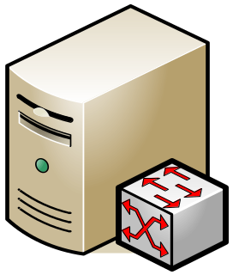



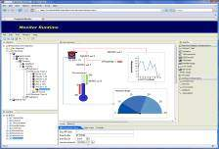








Customers use RAD to build Enterprise Java IT applications
1st Tier
2nd Tier
3rd Tier
IBM CICS
Transaction
Server
IBM InfoSphere
DB2
Oracle
IBM InfoSphere
IMS
SAP
PeopleSoft
...
REST style
Services
SCA
Web
Client
JSF
Web
Services
EJB
JPA
POJO
JavaScript
WebSphere Application Server
Portal Client
Tomcat
JBoss
Rich Java
GUI Client
InfoSphere
MashupHub
WebSphere
Portal Server

Slide 5
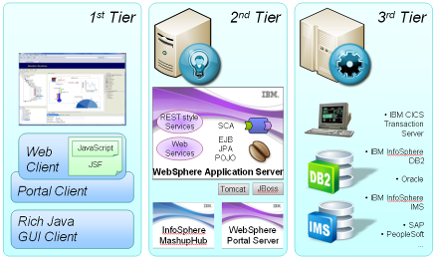
RAD includes tools for all aspects of IT application development
Core Development Tools:
  Productive tools for initial creation and
  updates of artifacts (web pages, EJBs,
  Web services, etc).
    Editors (source and graphical), wizards,
    validators, refactoring and quickfixes
  Dynamic testing, debugging, & profiling
    Deploying to WAS UTE, Universal Test
    Client to test Java or EJBs, Web Services
    Explorer, debuggers for each domain
      eg. Java, XSLT, Java Script, etc., Profiler
  Migration & N-2 support – from previous versions of RAD, also from previous spec levels.
  Target 2 previous server versions, for application creation and deployment (testing).
Lifecycle Tools:
  Code Analysis & Quality
    Line Level Code Coverage (LLCC), Code Quality rules
  Team Collaboration & Lifecycle integrations
    Rational Team Concert
    Clear Case, Clear Quest, Rational Asset Manager,, etc.

Slide 6
RAD Themes Overview
Theme 1: Support for Standards and Standards Currency
Tools to support JEE6 specifications (EJB 3.1, JPA 2.0, JSF 2.0, Servlet 3.0, ..), SCA
Ongoing support for WAS feature packs; JPA 2.0 tools, OSGI (Aries) Tools
Theme 2: Improve Developer Productivity
Support iterative creation, validation, revision and deletion of artifacts in support of JEE 6
Advanced Web 2.0 development tools to build rich internet applications
Comprehensive migration support from RAD 7.0.x and RAD 7.5.x
Theme 3: Improve Application Quality
Improve the static problem determination tools (line level code coverage enhancements)
Improve the dynamic problem determination tools: Debug tools supporting JEE6, enhanced profiling capabilities
Theme 4: Cloud support
Use RAD to access test server environments in the IBM public cloud
Theme 5: Exploit Integrations with other IBM products
WebSphere Application server test environment
WebSphere Portal server test environment
Rational Team Concert

Slide 7
Agenda
RAD Overview
General
Building the client tier
Building services
WebSphere Test Servers
Problem determination
Cloud development
Lifecycle

Slide 8
Flexible Install Options – get set up quickly
Built on Eclipse 3.6, IBM JRE 1.6
Install RAD…
  As a complete offering with its own Eclipse platform, or
  Into an existing Eclipse, if both are on the same Eclipse levels.
  3rd party plugins can be installed into RAD via P2 (Eclipse updater)
IBM Installation Manager simplifies and optimizes your install…
  Minimize footprint
    Default install size: 1.3 GB, full install of RAD 3.5 GB.
  Memory requirements: 2GB minimum, 3 GB recommend (This assumes running RAD and a WebSphere Test Environment)
  Enterprise install capabilities for simple maintenance and provisioning of your own standardized install configurations.
    Create response files for what install configuration you need.

Slide 9
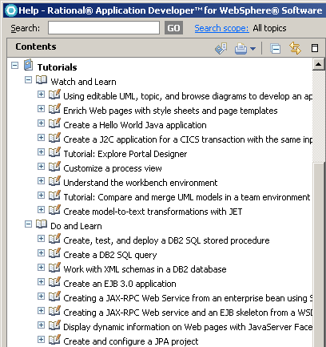
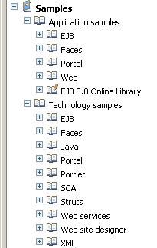
Building skills quickly: Wide Range of Help
Tutorials come in two flavors:
Watch and Learn
Watch as the tutorial is performed.
Do and Learn
Do the steps of the tutorial.
Samples come in two flavors:
Application Samples
Learn how to do application tasks in RAD.
Technology Samples
Get a better understanding of the underlying technology.
http://www.ibm.com/developerworks/wikis/display/rad/Home

Slide 10
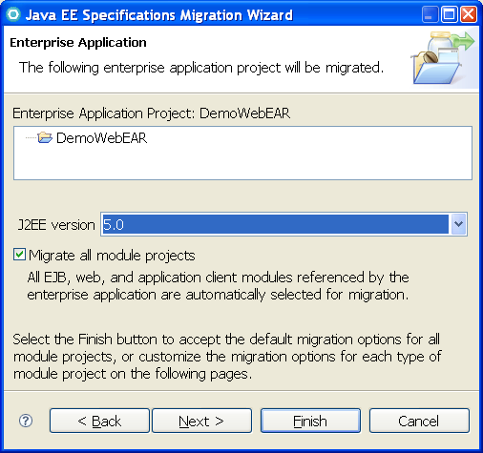
JEE Spec Migration tools
New “Spec Migration” wizard will migrate individual Java EE module projects from any of (1.1, 1.2, 1.3,1.4) to Java EE 5
Migrate entire Ear's (including contained modules)
Selected projects ‘server target’ automatically checked for compatibility with target version, and switched if necessary
Files that will change when moving
from Java EE 1.4 -> Java EE 5
  EJB: ejb-jar.xml
  Web: web.xml
  Ear: application.xml
  App client: application-client.xml
Any module containing
webservices.xml will migrate from
JSR109 1.1 -> JSR109 1.2

Slide 11
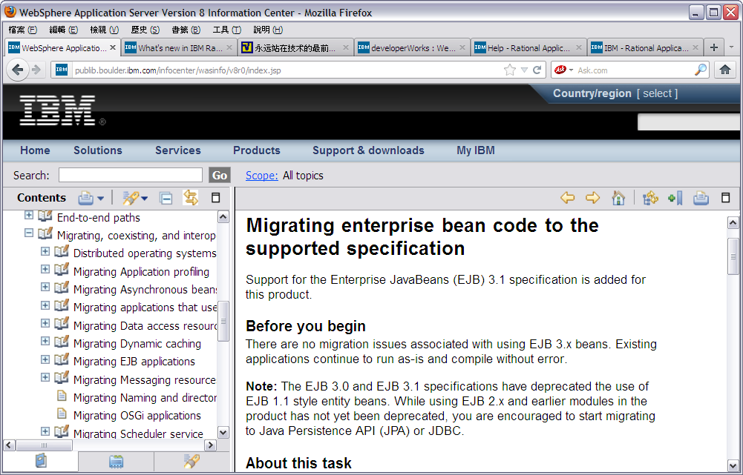
WAS 8.0 help 建議開始提升EJB 2.x

Slide 12
Agenda
RAD Overview
General
Building the client tier
Building services
WebSphere Test Servers
Problem determination
Cloud development
Lifecycle

Slide 13
RAD Client Tier Tools
RAD provides tools for helping build the Client Tier for your Applications. RAD supports:
Visual editing
Web 2.0 tools:
  iWidget capabilities
  JSF Tools
  JavaScript
  DOJO toolkit
Mobile computing

Slide 14
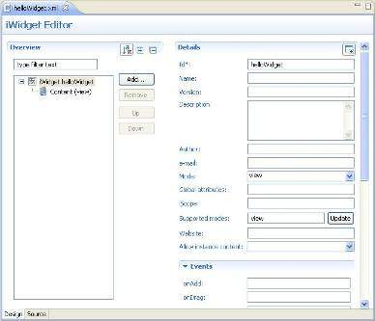
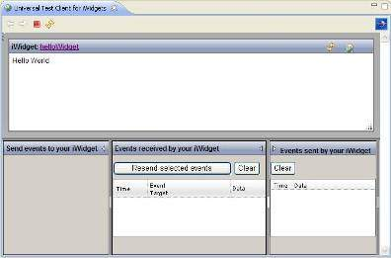
iWidget Development Tools
RAD now includes tools for creating and testing iWidgets, that can then be used in the IBM Mashup Center. The tools include:
A project facet that configures your project for iWidget development
A creation wizard that assists you with
creating a new iWidget
An editor for iWidget XML,
that includes validation function
A Universal Test Client
for testing the iWidget,
including the markup,
and the event handlers.

Slide 15
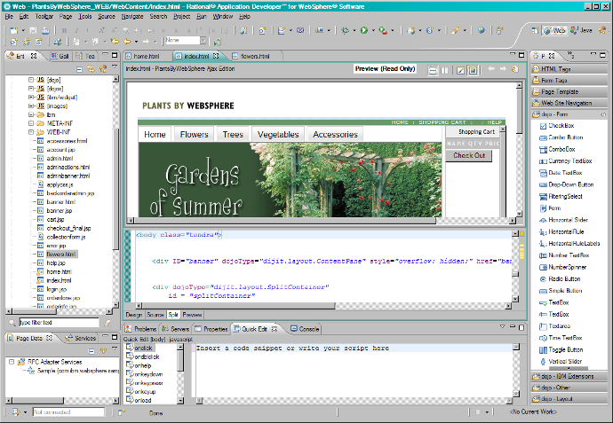
Design Dynamic Pages with Rational Page Designer
Split pane view allows you to see a synchronized source and design (or preview) view.
Construct pages by dragging and dropping rich web components from a customizable Palette
Construct pages by dragging and dropping rich web components from a customizable Palette
Property views allow easy customization of the selected component
Ability to import third party JSF or JavaScript libraries into RAD and have the widget show up on palette
The Data View lets you configure and drag and drop data to automatically create a data bound UI
The Quick Edit View allows scripting of client or server side events in Java or Java Script.
Code assist writes the code for you!
Web Application Development is Drag and Drop Simple!
  Rapid UI Creation
  Simple Data Access via JPA
Instant binding of UI to Services
Third party library support for JSF and JavaScript
Notes:
Page Designer is What You See Is What You Get (WYSIWYG) page authoring tool for HTML and JSP pages as well as page templates
Design mode lets you work in WYSIWYG mode
Source mode lets you work with the raw HTML and JSP with full content assist available
Split pane view lets you see source side by side design or preview view.
Palettes/drawers give you quick, easy access to most often used objects with drag and drop capability. The palette is customizable
Custom JSP tags supported as well
Page Designer
Split view option
Ability to split the page designer into a designer and source view
Horizontally or vertically
Absolute positioning
Positioning elements to an absolute position, via the design page.
The tool will apply the CSS style “position:absolute” to layout elements on the page.
Source page includes Significantly enhanced JavaScript support
Dojo widgets are on the palette and can be drag and dropped.

Slide 16
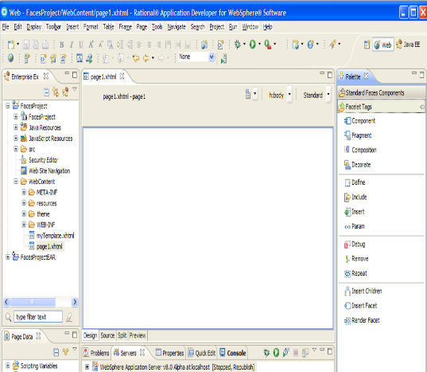
JSF 2.0
New in V8
JSF 2.0 introduces Facelets which is a new way to define JSF pages
Easily build custom, composite components using Facelets technology
New Facelet Tags are available on palette
New components are available (ie. Button, link, stylesheets and script components)
Any component can be configured to initiate an Ajax request
Improved navigation
Notes:
Installation
To install tracing support into a JSF application:
Open the JSF Trace view (by default, JSF Trace is configured to open automatically whenever you run a Faces page on the server). The view will show an informational message (because it cannot yet detect any data to present). See Figure 3.
Click the Add Tracing support link.
Optional: If you have more than one Web project in your workspace, you will be prompted to select what projects you want to add tracing to.
An informational message will inform you of potential drawbacks of tracing and ask you to confirm that you want to add tracing to the project. After you confirm that you do, the jsf-trace.jar file will be added to the project's WEB-INF/libfolder.

Slide 17
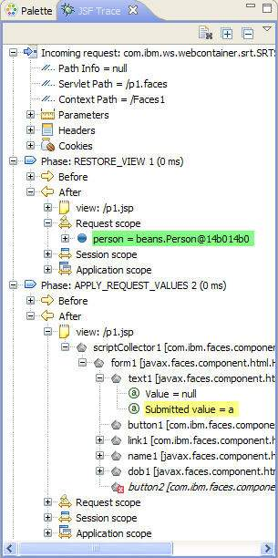
JSF Trace Tools
Debugging JSF applications can be hard
The server does not need to be in debug mode, and captures the following info:
  Incoming request (request path information, parameters, header, and cookies)
  All life cycle phases that were executed, including this information about each phase:
    Name, time spent, before & after state
  Messages that were logged
  Navigation that took place, including source and target pages, action that caused navigation, and an outcome of that action.
If the server is in debug mode, breakpoints can be set, and watches set on objects
JSF trace view opens (and can be configured) when you open a faces page
Notes:
Installation
To install tracing support into a JSF application:
Open the JSF Trace view (by default, JSF Trace is configured to open automatically whenever you run a Faces page on the server). The view will show an informational message (because it cannot yet detect any data to present). See Figure 3.
Click the Add Tracing support link.
Optional: If you have more than one Web project in your workspace, you will be prompted to select what projects you want to add tracing to.
An informational message will inform you of potential drawbacks of tracing and ask you to confirm that you want to add tracing to the project. After you confirm that you do, the jsf-trace.jar file will be added to the project's WEB-INF/libfolder.

Slide 18
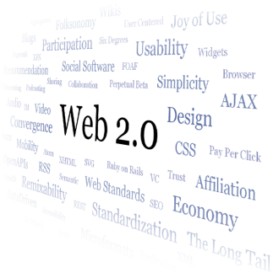

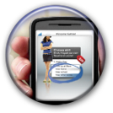
RAD - Simplified Web 2.0 Development
New in V8
Use RAD to build rich internet applications to improve online user experience and increase customer satisfaction
Lower the barriers of adoption of Web 2.0 technologies
  Visual development of Web 2.0 pages
  Source level tools to aid with Javascipt and dojo development
  Debug capabilities with Firebug integration
  Multiple browser previews
  Expose server side assets as Web 2.0 consumable services
Lightweight Ajax test server to rapidly preview web pages that include images, scripts, services, and data

Slide 19
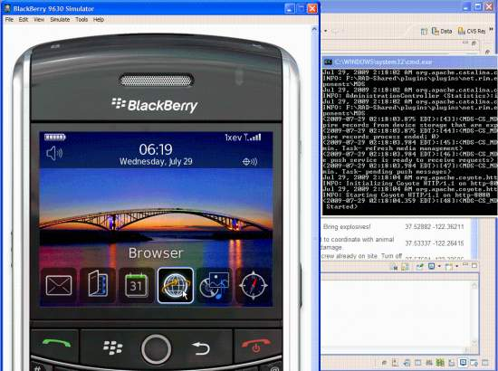
Developing mobile applications in RAD
RAD can be used to develop WAS applications that
are accessed via browsers on mobile devices,
such as BlackBerrys
There is a BlackBerry
and Android simulator that can be
installed into RAD,
and used to test the
application
For Blackberry: www.blackberry.com
/developers/ibmrad

Slide 20
Agenda
RAD Overview
General
Building the client tier
Building services
WebSphere Test Servers
Problem determination
Cloud development
Lifecycle

Slide 21
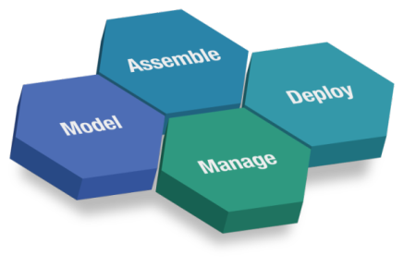
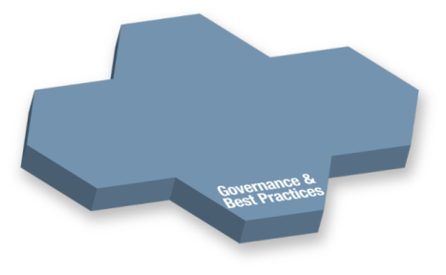
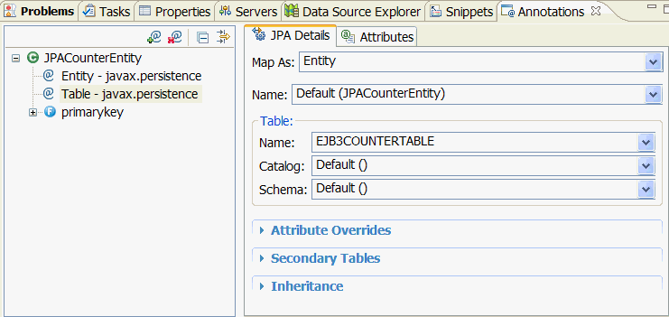

Java Platform Enterprise Edition (JEE)
A standard programming model that provides functionality to deploy fault-tolerant, distributed, multi-tier Java software, based largely on modular components running on an application server.
A Java EE app server handles transactions, security, scalability, concurrency and management of the components.
Specs specific to EE are: EJBs, Connectors, servlets, portlets, JSPs and web services.
RAD
WAS

Slide 22
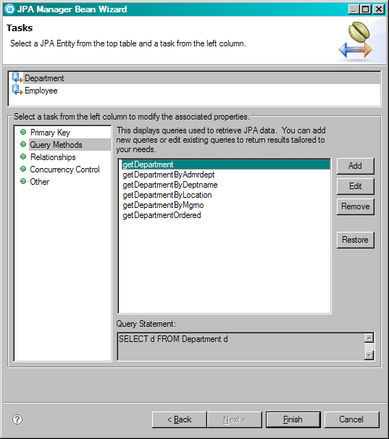
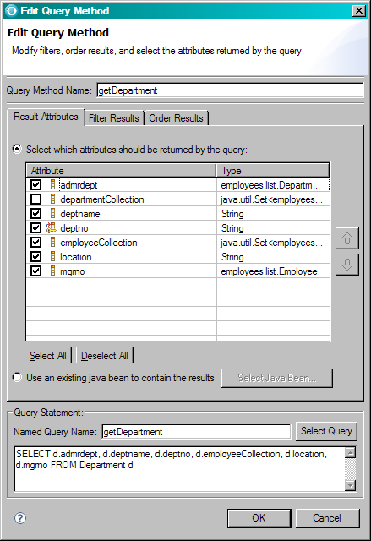
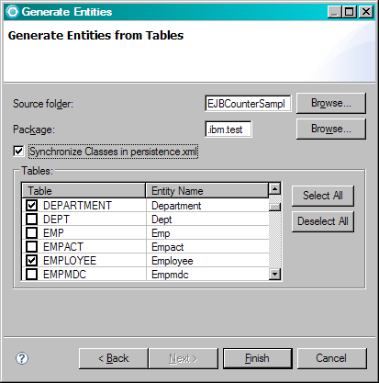
RAD supports JPA 2.0 tools
Create and automatically initialize mappings:
  Top-down: Create new database tables from existing entity beans.
  Bottom-up: Create new entity beans from existing database tables.
  Meet-in-the-middle: Define mappings between existing database tables and entity beans.
Filter results
Generate entities
Create Manager Beans

Slide 23
Web Services support
RAD support for JAX-RS (REST style Web Services)
Manage any number of JAX-RS libraries
  Automatic integration with the WAS JAX-RS support (in the Web 2.0 FEP)
  A new preference page can be used to import JAX-RS libraries
Editor support for JAX-RS annotations, to guide developers usage
  Also includes validation with the JSR-311 specification
JAX-RS Quick Fixes to simplify development of REST applications
  Available for java code, and the web.xml file
SAML support (A security assertion mechanism, enabling “single sign-on”)
The support configures the project, and ensures WAS deployment compatibility
The Policy Set attachment wizard now supports SAML, and custom bindings creation for the Web Service Provider
Numerous scenarios are supported, and a SAML sample has been added
New Editors for policy set binding configurations
Editors provide validation based on the schema and additional rules
  Can also create new bindings, using the general bindings as templates
Defaults are set up for supported security tokens
Notes:
JAX-RS provides support for REST style Web Services
Support added to WAS via the Web 2.0 FEP
RAD support for JAX-RS:
Manage any number of JAX-RS libraries
Preference page to import JAX-RS libraries
Integration with WAS Web 2.0 FEP for easy configuration
Configure the JAX-RS library associated with the project via a JAX-RS facet
JAX-RS Annotations to guide users
Provides validation against the JSR-311 specification
JAX-RS Quick Fixes to simplify development of REST applications
Available for java code, and the web.xml file
SAML support (added in 7.5.5)
SAML is used as a Security Assertion in securing Web Service Transactions, enabling “single sign-on”
Support for SAML (Security Assertion Markup Language) was added to WebSphere as a Feature In Service (FIS) in WAS 7.0.0.7
A new SAML project facet, enables access to the saml.jar, and prevents publishing if the target server is not WAS 7.0.0.7 or later
The Policy Set attachment wizard now supports SAML, and custom bindings creation for the Web Service Provider
Previously, the admin console was used to create custom bindings
Numerous scenarios are supported, using the SAML token as an Authentication token
A sample has been added to demonstrate use of a SAML token
Policy Binding Configuration (7.5.5)
New Editors for policy set binding configurations
These Editors allow for all possible configurations allowed by the binding file schema.
Provide Validation for the binding file based on the schema and other extra validations that RAD tools added to the editors.
Editors are invoked from the JAX-WS Service Provider / Client in the Services view
Can also create new Bindings based on General Bindings as templates
Defaults set up for supported security tokens

Slide 24
Agenda
RAD Overview
General
Building the client tier
Building services
WebSphere Test Servers
Problem determination
Cloud development
Lifecycle

Slide 25
WebSphere Test Environment support
WebSphere Application Server 6.0 (Remote support)
    Includes support for Web 2.0 feature pack
WebSphere Application Server 6.1
    Includes support for EJB 3.0, Web Services and Web 2.0 feature pack
WebSphere Application Server 7.0
    Includes support for Web 2.0, SCA, XML, OSGi and JPA, and CEA feature packs
WebSphere Application Server 8.0
WebSphere Portal Server 6.1 (stub support)
WebSphere Portal Server 7.0 Beta
Remote deployment to all WebSphere servers listed above
Universal test client to dynamically test your applications
New in V8
New in V8

Slide 26
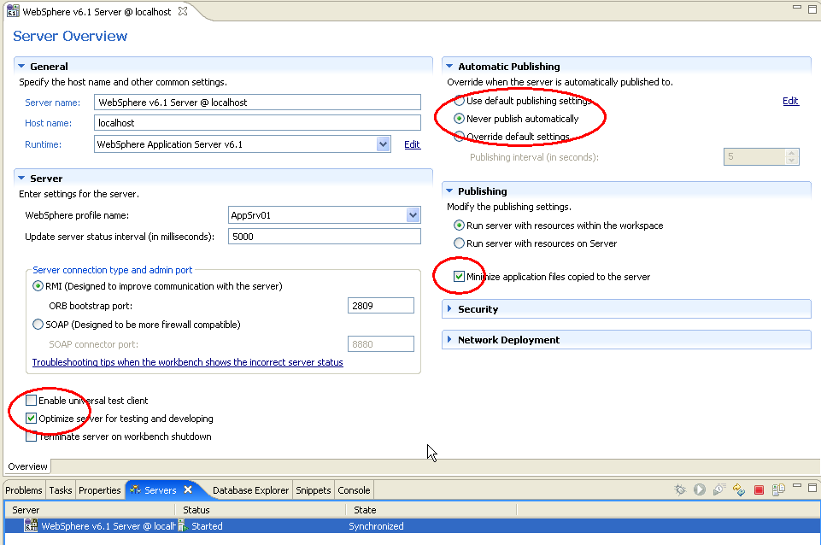
WebSphere Test Environment support
Publishing to WebSphere
Support for exporting and publishing to WebSphere
Support for hot deploy
  Ability for WebSphere to recognize a change to the archive file and automatically update the server
Support for automatic update
  Changes in the workspace are automatically updated to the server
Server Tuning Options
Be aware of the different server options
Can also run the server on a different machine

Slide 27
Agenda
RAD Overview
General
Building the client tier
Building services
WebSphere Test Servers
Problem determination
Cloud development
Lifecycle

Slide 28
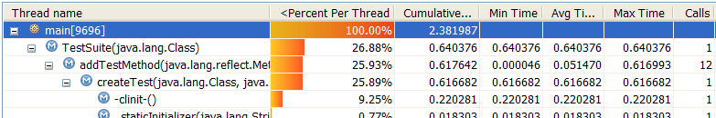
Problem determination tools
Problem determination tools help find problems during the development lifecycle of your application
Dynamic tools that help find problems at runtime whether it is debugging the code or profiling the code on the WebSphere Application Server
Static tools that help find problems in the developed code via line level code coverage or static analysis
RAD
WAS

Slide 29
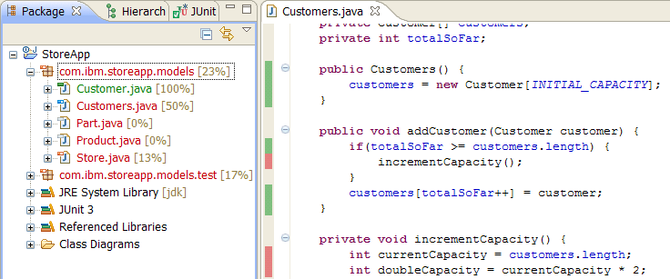
Dynamic Code Coverage
New in V8
Provides detailed information on what code paths have been encountered during program execution
As users interact with a web app, the user will see coverage statistics get dynamically updated as they run through certain scenarios (instead of waiting for user's app to complete).
Powerful tool to help determine xUnit test coverage, potential dead code
Command line and Ant capability for build integration
  JUnit, code coverage data collection and html report generation

Slide 30
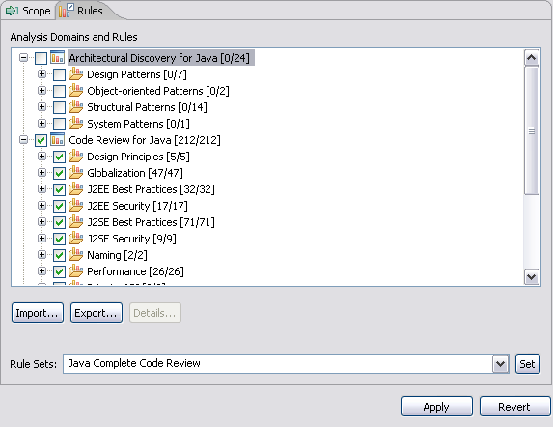
RAD Helps with Code Quality Assurance
Analyze Project/Workspace to find problems of various types:
  Globalization
  J2EE & J2SE Best Practices
  J2EE & J2SE Security
  Naming
  Performance
  Private API
Produce interactive reports with violations and metrics
Provides explanations, examples, and quick fixes for problems
Allow users to create, enable and disable validation rules
Allow users to create their own rules based on rule templates
  Complete Code Review (400+ rules)

Slide 31
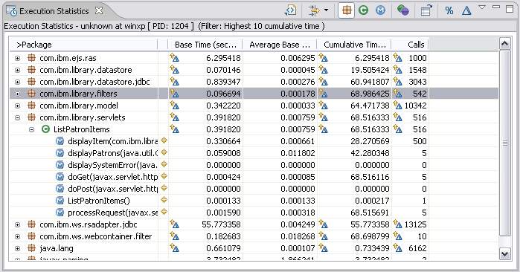
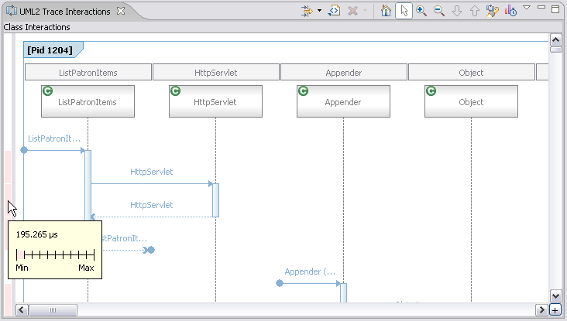
Performance and memory testing to detect problems sooner
Start WAS in Profile Mode
  Configure profiling set for analysis
Begin Monitoring the application
  Exercise scenarios for profile run
Analyze
  Tables and graph views to analyze profiling data
  Tune Java code to address performance & memory issues
  Timing
  Memory statistics
Probekit - allows you to write your own probes
Notes:
Within RAD, the runtime analysis feature allows you to view the actual execution of the code, which may be different from the intended behavior. With profiling, you can analyze performance, method execution sequences, thread behaviors and code coverage.
With the Runtime Analysis feature, you can do:
Performance Analysis: users can collect method level performance data and view it through statistical views or via the performance call graph
Memory Leak Analysis: users can find memory leaks within their Java code. The leaks can be viewed using the Object Reference Graph to better explore relationships of the object to other objects.
Line Level Code Coverage: shows what code has been executed down to the line level.
Thread Analysis: within a view, thread-view of the behavior code is shown.
The monitoring tools help you to identify performance and memory usage problems in your Java™ and Web applications, regardless of the application server on which you are running.
The profiling tool enables you to collect and display data related to the runtime behavior of your Java program. It can help you identify problems related to application performance by showing which operations take the most time, are repeated most often, or result in memory leaks.
Probekit allows you to write probes, which are small fragments of Java code. By invoking these at specified points during the execution of your Java class, you can collect runtime data about the application. You can use these probes to profile your application by collecting only the data that you want.
All runtime analysis instrumentation is specified via profile configurations (done through a wizard).
Isolate and fix performance problems
Advanced features including:
Execution Stats
Log Navigator and View
Memory Stats
Method Invocation
Object References
Profiling Monitor
Statistical Graph and Graph Summaries
Statistical Data
UML Sequence Diagram
UML Log Interactions
UML Trace Interactions
Static and Dynamic Probe Kit
Probe Kit Editor
J2EE Request Profiler
PI-Agent
RAC Security Extension
Profiling tools can seamlessly trace across multiple servers

Slide 32
Debug Tools
J2EE/Web application debugging
    Advanced debug support for Websphere Application Server, including EJBs, SCA components, JSP pages and servlets.
XSLT debugger
    The XSLT debugger enables you to detect and diagnose errors in XSLT Transformations
Step-by-Step Debugging
    Control debugging at a higher level. Provide user the ability to stop on entry to every object loaded by the JVM or server.
    Supported object types: Web objects, XSLT
Logical display of complex variable types
    Display variables in a logical manner, allowing the user to examine variables more easily.
    Supported complex variable types: JSP 2.0 Implicit object variables, EMF, DOM
Java and mixed language debugger
    Seemless debugging of Java calls to ‘other language’ programs (eg. SCA, C++) & vise versa
Debugger for WebSphere Jython Scripts

Slide 33
Agenda
RAD Overview
General
Building the client tier
Building services
WebSphere Test Servers
Problem determination
Cloud development
Lifecycle

Slide 34


What’s new in v8 - Support for the Cloud
New in V8
RAD / RSA on the desktop
  Provision and work with WAS on the Cloud.
Desktop
RAD
Browser
Web UI
API
Cloud
WAS
IBM Smart Business Development and Test on the IBM Cloud.

Slide 35
Agenda
RAD Overview
General
Building the client tier
Building services
WebSphere Test Servers
Problem determination
Cloud development
Lifecycle

Slide 36
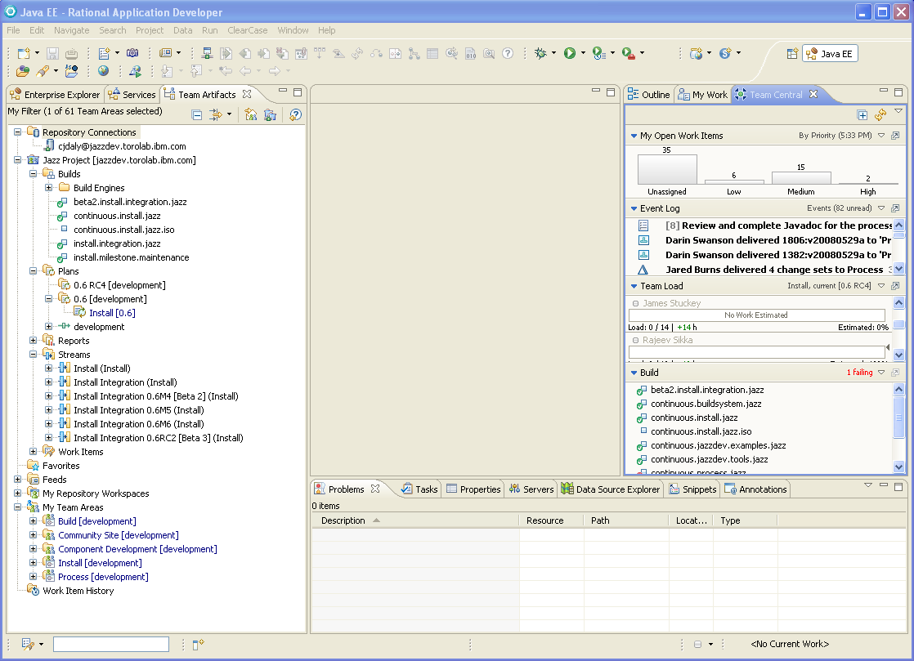
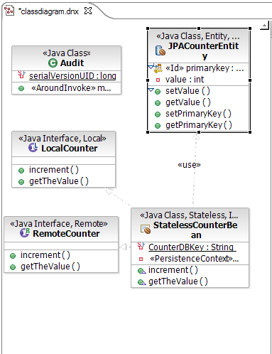
RTC Views & Capabilities integrate with RAD
Work with your Web & Java EE development artifacts in the ‘Team Artifacts’ view
code
diagrams
Metadata
…
Develop in RAD and RSA perspectives (Modeling, Java EE, …)
Use Jazz change management constructs and work flows
change sets
suspend/resume
server workspaces, …
Manage your workload in the ‘Team Central’ and ‘My Work’ views

Slide 37
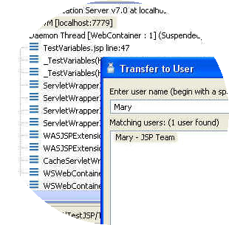
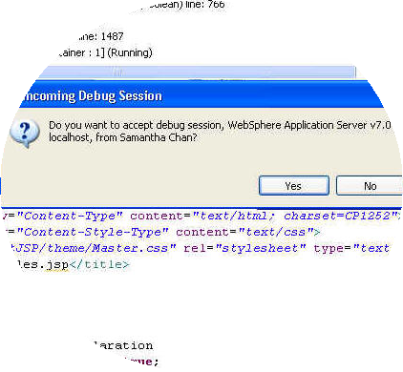




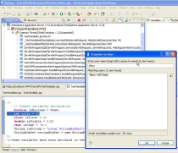
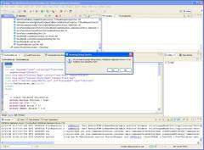



Leveraging Rational Team Concert
RAD and RTC integrate to:
Share live debug sessions between team members
WebSphere
Application
Server
Rational
Application Developer
Rational
Application Developer
Rational
Team Concert Developer
Rational
Team Concert Developer

Slide 38
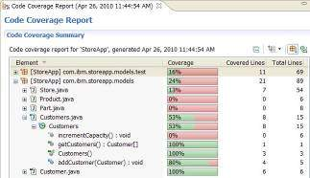
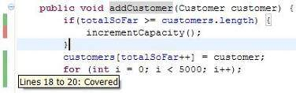
Extend team collaboration to IBM middleware developers
New in V8
Share code coverage information from automated testcase execution
Improve test coverage and quality based on code coverage results
Rational Application Developer
Rational Application Developer
Rational Team Concert Developer
Rational Team Concert Developer
Notes:
The llc jar files are placed in the build environment so you if you are running llc – it will just simply the configuration
Need to create an ant file to configure llc to run the junit tests
Ability to view the results of the line level code coverage
Ability to import the llc results into your workspace
Able to look at the code coverage and create a work item to improve it

Slide 39
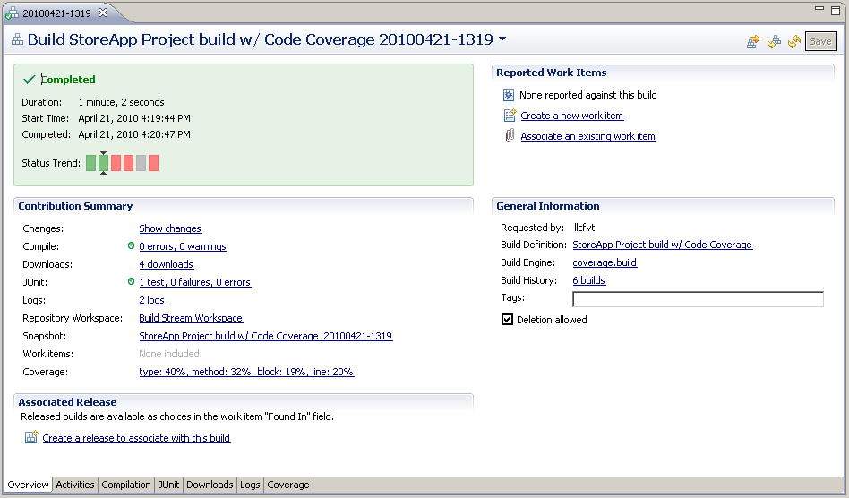
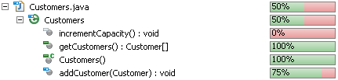
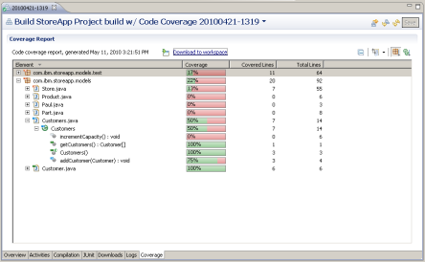
Code Coverage Integration with RTC
New in V8
Client side
  RTC Build details viewer extension – RAD and Web browser
    Show summary of code coverage statistics
    Additional Code Coverage tab to show detailed coverage statistics report
  Integrated work item search and creation
  Import to local workspace for rich viewing in navigator and source views

Slide 40

Notes:
Author Notes:
Optional IBM Rational “Questions” Breaker Slide

Slide 41

www.ibm.com/software/rational
© Copyright IBM Corporation 2010. All rights reserved. The information contained in these materials is provided for informational purposes only, and is provided AS IS without warranty of any kind, express or implied. IBM shall not be responsible for any damages arising out of the use of, or otherwise related to, these materials. Nothing contained in these materials is intended to, nor shall have the effect of, creating any warranties or representations from IBM or its suppliers or licensors, or altering the terms and conditions of the applicable license agreement governing the use of IBM software. References in these materials to IBM products, programs, or services do not imply that they will be available in all countries in which IBM operates. Product release dates and/or capabilities referenced in these materials may change at any time at IBM’s sole discretion based on market opportunities or other factors, and are not intended to be a commitment to future
product or feature availability in any way. IBM, the IBM logo, Rational, the Rational logo, Telelogic, the Telelogic logo, and other IBM products and services
are trademarks of the International Business Machines Corporation, in the United States, other countries or both. Other company, product,
or service names may be trademarks or service marks of others.
Notes:
Author Notes:
Mandatory standard closing slide for IBM session track presenters. Not needed for non-IBM presenters.
Additional URLs:
IBM Rational software: www.ibm.com/software/rational
Rational launch announcements: www.ibm.com/software/rational/announce/
Rational Software Delivery Platform: www.ibm.com/software/info/developer
Accelerate change and delivery: www.ibm.com/software/rational/offerings/scm.html
Deliver enduring quality: www.ibm.com/software/rational/offerings/testing.html
Enable enterprise modernization: www.ibm.com/software/info/developer/solutions/em/index.jsp
Ensure Web site security and compliance: www.ibm.com/software/rational/offerings/websecurity/
Improve project success: www.ibm.com/software/rational/offerings/lifecycle.html
Manage architecture: www.ibm.com/software/rational/offerings/design.html
Manage evolving requirements: www.ibm.com/software/rational/offerings/irm/
Small and midsized business: www.ibm.com/software/rational/smb/
Targeted solutions: www.ibm.com/software/info/developer/solutions/index.jsp
Rational trial downloads: www.ibm.com/developerworks/rational/downloads
Leading Innovation Web site: www.ibm.com/software/rational/leadership
developerWorks Rational: www.ibm.com/developerworks/rational
IBM Rational TV: www.ibm.com/software/info/television/index.jsp?cat=rational&media=video&item=en_us/rational/xml/M259765N40519Z80.xml
IBM Rational Business Partners: www.ibm.com/partnerworld/pwhome.nsf/weblook/index.html
IBM Rational Case Studies: www.ibm.com/software/success/cssdb.nsf/topstoriesFM?OpenForm&Site=rational

Slide 42
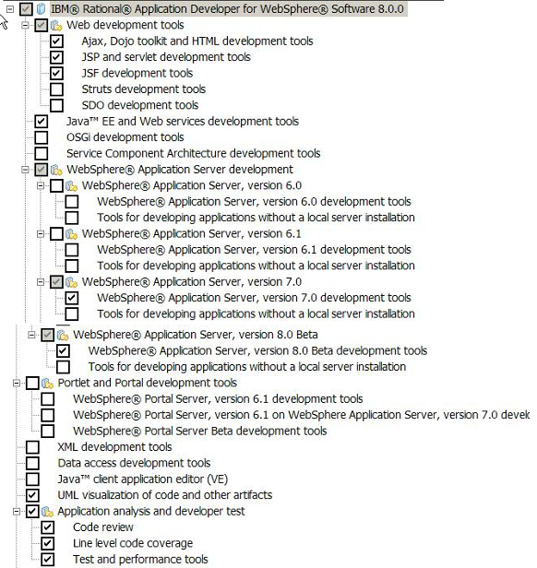
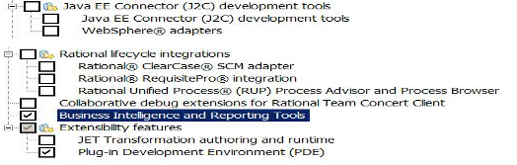
RAD Default Install – 1.3 GB

